Slide 1

Y
O
L
O
YOU
ONLY
LOOK
ONCE
a Deep Dive
Jeevan | Shreya | Khushi | Kashish | Ameya | Sravani

Slide 2
Image/Object Detection
Detection of object in a given image has a wide range of real-world applications
Disease Detection
(X-rays, MRI etc.)
Manufacturing
Quality control
Facial recognition
Law Enforcement
Healthcare
Robotics
Security
Agriculture
Transportation
Crop health
Pest detection
Self Driving Cars
Delivery robots

Slide 3
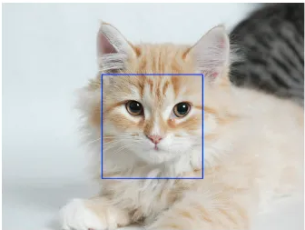
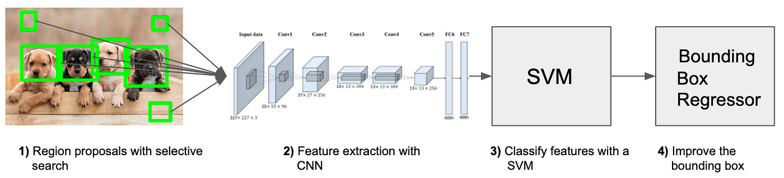
the journey of Object Detection
Sliding Window –
Exhaustive
Haar Cascades
Deformable Parts
R-CNN –
Basic
Fast R-CNN
Faster R-CNN
SSMD (Single Shot Multibox detector)
RetinaNet

Slide 4
the birth of YOLO
Model | Speed (FPS) | Major Drawback
Sliding Window | ~few minutes/image | Too slow, inefficient
R-CNN | ~50 sec/image | Not real time processing
Fast R-CNN | ~2 sec/image | Not real time processing
Faster R-CNN | ~5 FPS | Slow for live applications
SSD | ~59 FPS | Struggles for small objects
What if the entire image can be processed in a single pass? - YOLO
YOLO –
Single regression problem
Directly predicts bounding boxes and class labels in one pass
~45 FPS (YOLO V1)
Real time object detection

Slide 5
YOLO
V1

Slide 6
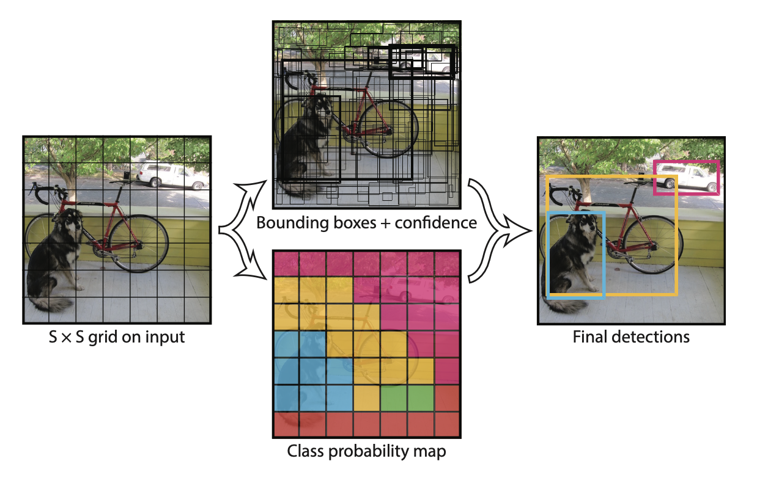
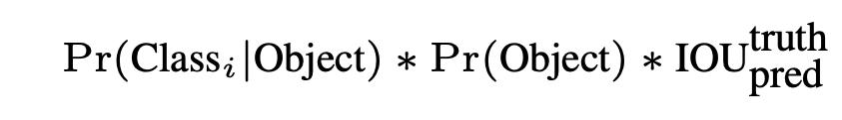
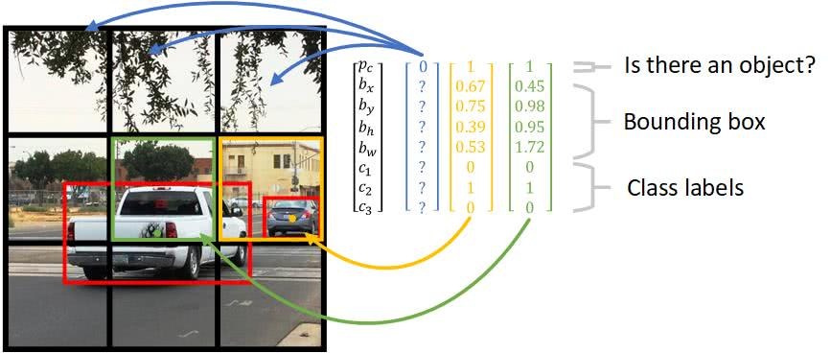
Architecture
Divides the image into an S × S grid (e.g., 7×7).
Each grid cell predicts:
Bounding box coordinates (x, y, w, h)
Confidence score (how sure YOLO is about the object’s presence)
Intersection over Union (IOU)
Class probabilities (what object is in the box) -
Formula for Total Predictions per Image:
S × S × ( B × 5 + C )
Network Design
Inspired by GoogLeNet
PASCAL VOC Dataset
24 Convolutional layers followed by 2 fully connected layers
Fast YOLO

Slide 7
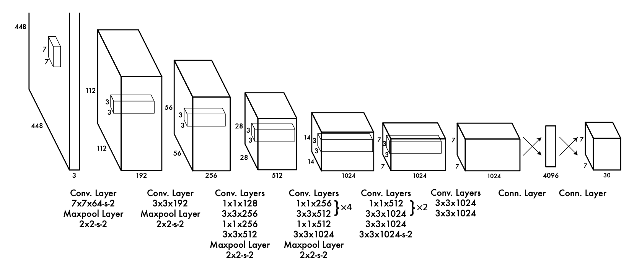
Training
Pretraining on ImageNet:
general image features
It uses only the first 20 layers of YOLO’s architecture to do image classification
Fine-Tuning for Object Detection:
The next 4 convolutional layer and the 2 fully connected layer
Increasing the Input Image 224×224 pixels (used in ImageNet) to 448×448 pixels
Prediction
Optimizing the Model
Minimizing errors using sum-squared error loss (which measures how wrong the predictions are)
Training Setup
PASCAL VOC Dataset.
The training process takes 135 rounds (epochs).
Batch size = 64, meaning it processes 64 images at a time.

Slide 8
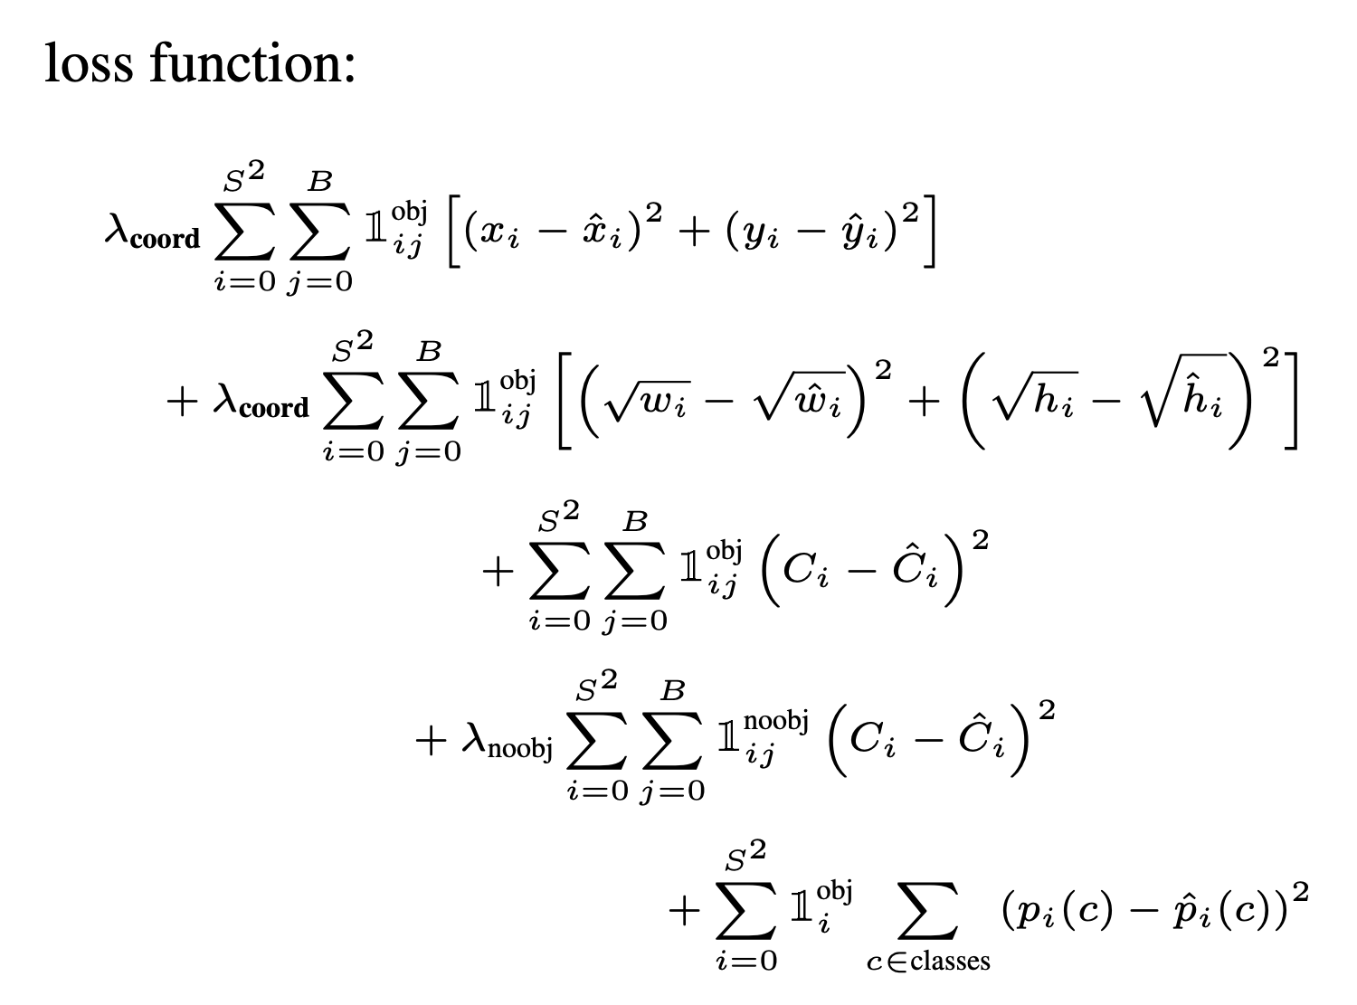
Components of YOLO Loss Function
Localization Loss (Bounding Box Errors)
Measures errors in x, y, w, h of predicted bounding boxes.
Uses sum-squared error, which treats small and large box errors equally (not ideal).
Solution: Instead of predicting w and h directly, YOLO predicts their square roots to make small errors more significant.
Confidence Loss (Object Presence Confidence)
Ensures YOLO is confident when detecting objects.
If no object is present, confidence should be 0.
Issue: Too many grid cells predict “no object,” making training unstable.
Solution: YOLO reduces the importance of confidence loss for empty cells using λ _{noobj} = 0.5
Classification Loss (Class Probability Errors)
If an object is present in a grid cell, YOLO predicts class probabilities.
Uses standard sum-squared error for classification.

Slide 9
YOLO
V5

Slide 10
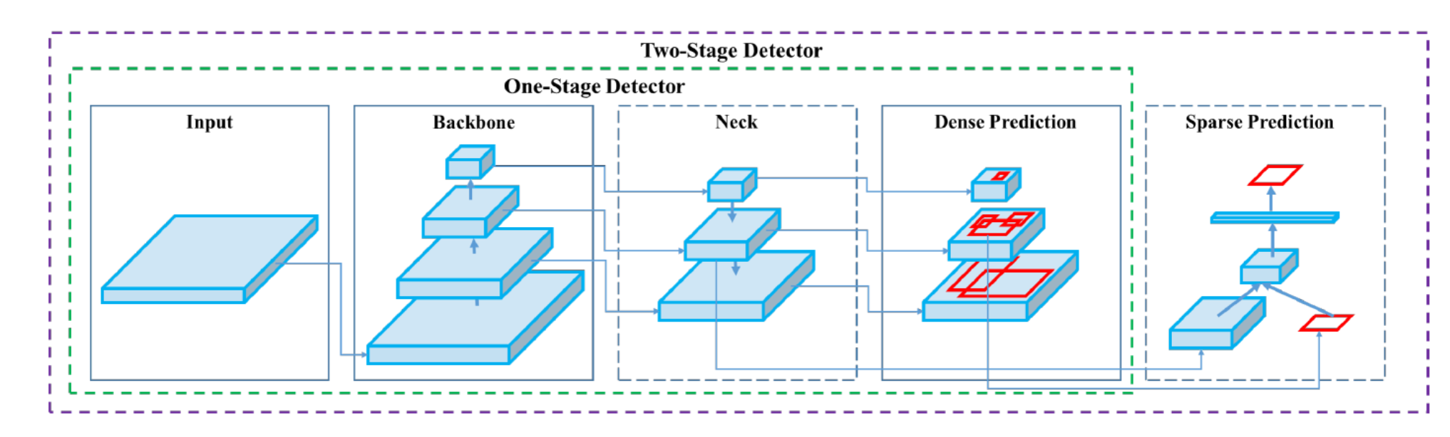
Architecture
CSPDarknet53 Backbone
Cross-Stage Partial Networks (CSPNet) split input features into two parts, processing one through residual blocks while passing the other directly to later layers.
Neck
The Neck of YOLOv5 uses Path Aggregation Network (PA-Net) to combine and refine feature maps before sending them to the detection layer.
Head
The head is the final stage of YOLOv5. It takes refined feature maps from the neck and produces object bounding box coordinates, confidence scores, and object class probabilities.

Slide 11
Features
Data Augmentation
YOLOv5 incorporates advanced augmentation techniques to improve generalization.
During each training epoch, images are subjected to a series of augmentations through an online data loader, including Scaling, Color Space Manipulation, Mosaic augmentation.
Loss Calculation
The Loss function is a composite metric calculated from three primary components: Binary Cross-Entropy (BCE) for class prediction and objectness, and Complete Intersection over Union (CIoU) for localization.
These loss components are carefully designed to optimize mean average precision (mAP)
Bounding Box Anchors
YOLOv5 utilizes K-means clustering and genetic algorithms to optimize anchor box dimensions, improving localization accuracy.
16 Bit Floating Point Precision:
YOLOv5 supports 16-bit floating point precision (FP16) on modern GPUs.
This reduces memory usage and speeds up inference, making it ideal for real-time applications.

Slide 12
Major differences of Yolo V5 over Yolo V1
Aspects | YOLO V1 | YOLO V5
Framework | Implemented in Darknet | Implemented in PyTorch
Backbone Network | Custom CNN with 24 convolutional layers | CSPDarknet53 (Cross-Stage Partial Darknet)
Feature Extraction | Extracts single-scale features | Extracts multi-scale features
Detection Method | Grid-based detection – Divides image into S×S grid cells | Anchor-based detection – Uses predefined anchor boxes
Bounding Box Prediction | Each grid cell predicts 2 bounding boxes | Each anchor box predicts multiple bounding boxes
Data Augmentation | Basic transformations (flipping, scaling) | Mosaic augmentation, color transformations, scaling, flipping
Model Scalability | Single Model | Multiple versions: YOLOv5n, s, m, l, x for different hardware constraints

Slide 13
YOLO
V8

Slide 14
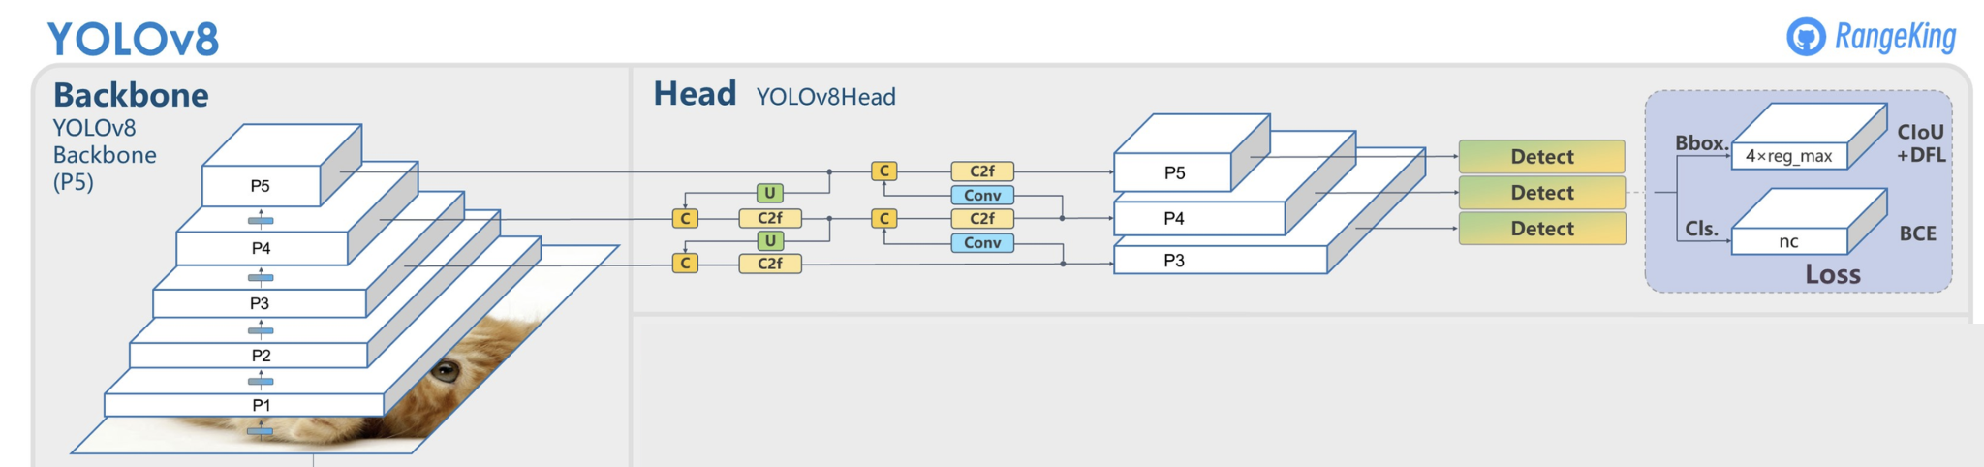
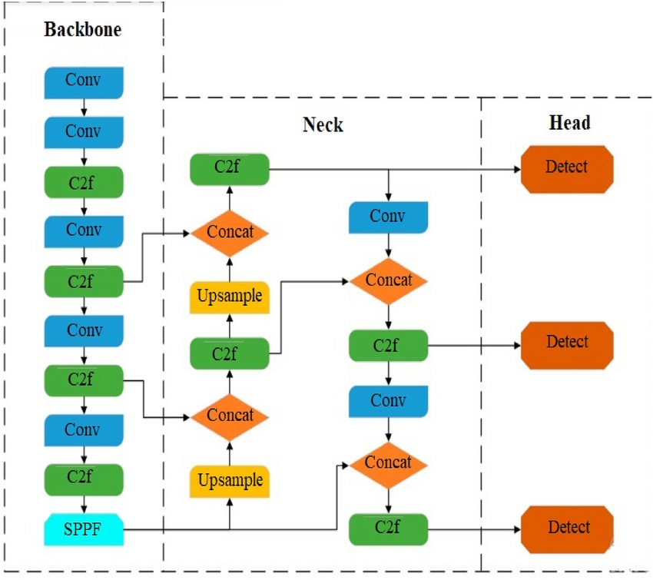
Architecture
Input Image
The image is resized to a fixed resolution and fed into the model.
Backbone (Feature Extractor)
Uses an improved CSPDarkNet architecture with C2f module for better feature extraction.
Extracts key features (edges, shapes, textures) from an image.
Neck (Feature Refinement)
FPN (Feature Pyramid Network): Helps detect objects at different scales (small, medium, large).
PAN (Path Aggregation Network): Enhances feature flow for better localization and classification.
Head (Final Decision-Maker)
Instead of using anchor boxes, it directly makes the final predictions:
Bounding Boxes: Coordinates of detected objects.
Class Labels: What the object is (e.g., car, person).
Confidence Scores: How confident the model is about the prediction.
Output
Final detections with bounding boxes, labels, and confidence scores.

Slide 15
Loss function and Training Process
How does the model learn?
When YOLOv8 detects objects, it makes three types of predictions: Object classification, Bounding Box and Confidence scores.
To train the model, YOLOv8 calculates errors (loss) in each of these predictions and adjusts its weights using backpropagation.
Loss Components:
Localization Loss (Box Loss)
Uses CIoU(Complete IoU Loss) to measure how well the predicted bounding box align with ground truth boxes.
More accurate for small and fast-moving objects compared to GIoU as it also considers the aspect ratio and center distance of bounding boxes.
Classification Loss (Binary Cross-Entropy Loss)
Measures how well the predicted labels align with the actual object labels.
Distribution Focal Loss (DFL)
Refines bounding box positions by reducing penalties for small coordinate variations, improving localization precision.
Loss Function: L = L_{box} + L_{cls} + L_{dfl}
Why does YOLOv8 use AdamW instead of SGD?
SGD (Stochastic Gradient Descent) is good for general optimization, but it struggles with deep networks like YOLOv8.
AdamW trains the model faster and prevents overfitting, making it better for object detection.
How does YOLOv8 train efficiently?
If the learning rate is too high, the model jumps around and never finds the best solution. If it’s too low, the model learns too slowly and might get stuck. Hence, YOLOv8 uses a decaying learning rate strategy
Starts with a higher learning rate (to learn fast in the beginning).
Gradually reduces over time (so the model fine-tunes its accuracy).

Slide 16
Major differences of Yolo V8 over Yolo V5
Feature | YOLO V5 | YOLO V8
Detection Type | Anchor-Based (uses predefined anchor boxes for object detection) | Anchor-Free (more flexible and accurate detection)
Feature Extraction (Backbone) | CSPDarkNet (Cross-Stage Partial Network) | Improved CSPDarkNet with C2f (Cross Stage Partial with Two Fusion)
Bounding Box Regression | Uses GIoU (Generalized IoU) Loss | Uses CIoU (Complete IoU) Loss (better for small & fast-moving objects)
Training Process | Manual tuning of anchor boxes | No anchor boxes → Easier & faster training
Performance (Speed & FPS) | ~40 FPS on 1080p video | 50 FPS on 1080p video
Accuracy (mAP@50) | ~95% | 99.1% (after fine-tuning)
Post-Processing (NMS) | Standard Non-Maximum Suppression | Improved NMS (better at removing duplicate detections)

Slide 17
Applications
Self-Driving Cars
It helps detect pedestrians, vehicles, and obstacles in real time, making autonomous driving safer.
Medical Imaging
Used in hospitals to detect tumors, cancerous cells and abnormalities in X-rays and MRIs faster and more accurately.
Security & Surveillance
AI-powered smart cameras can detect threats more efficiently in crowded places.
Drone & Bird Detection
The research paper shows how YOLO v8 can accurately track flying objects like UAVs in real time, which is useful for military surveillance and air traffic monitoring.
Retail & Inventory
Used in stores for product detection to automate checkout (like Amazon Go, where you grab products and walk out without checkout).
Wildlife Conservation
Helps track endangered animals and detect poachers using drone footage.

Slide 18
YOLO
V10

Slide 19
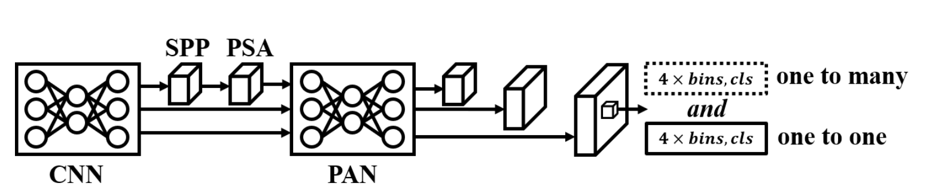
Architecture
Hybrid Backbone
YOLOv10 builds on a one-stage CNN backbone with an enhanced CSPNet and integrates transformer-based modules (e.g. Partial Self-Attention) to capture global features​
Dual-Head Design
It introduces two parallel detection heads: a traditional one-to-many head and an additional one-to-one head. The one-to-many branch provides multiple predictions per object (as in prior YOLOs), while the one-to-one branch gives a single high-confidence prediction per object​. This dual-head architecture enables end-to-end detection without NMS post-processing, a first for the YOLO series
Rank-guided Block Design
Using compact inverted bottleneck blocks with depth wise convolutions in select stages – to reduce redundancy in later layers​. By adaptively replacing standard layers with these lightweight blocks (based on layer-wise rank analysis), YOLOv10 achieves higher efficiency without sacrificing accuracy.

Slide 20
Implementation Details
Dual Label Assignment
YOLOv10’s training strategy combines one-to-many and one-to-one label assignments. It adds a one-to-one matching head (mirroring the regular head) so that during training both heads learn jointly. The one-to-many head supplies dense supervision, while the one-to-one head (using top-1 matching akin to DETR) learns to output one best box per ground truth. At inference, the one-to-many head is dropped and only the one-to-one head is used, yielding NMS-free predictions​.
Lightweight Classification Head
YOLOv10 replaces the bulky classification sub-network from YOLOv8 with a streamlined version. The class head is built from two depthwise-separable 3×3 conv layers followed by a 1×1 conv. This significantly cuts the classifier’s FLOPs and parameters (in YOLOv8-S, the class head used ~2.5× more compute than the regressor​) with minimal impact on mAP.
Optimized Downsampling
It uses spatial-channel decoupled downsampling to reduce. Instead of a single heavy strided conv, YOLOv10 first applies a 1×1 pointwise conv to reduce channel dimensions, then a depthwise conv with stride 2 for spatial downsample​. This decoupling preserves more information while lowering computation, contributing to faster inference.

Slide 21
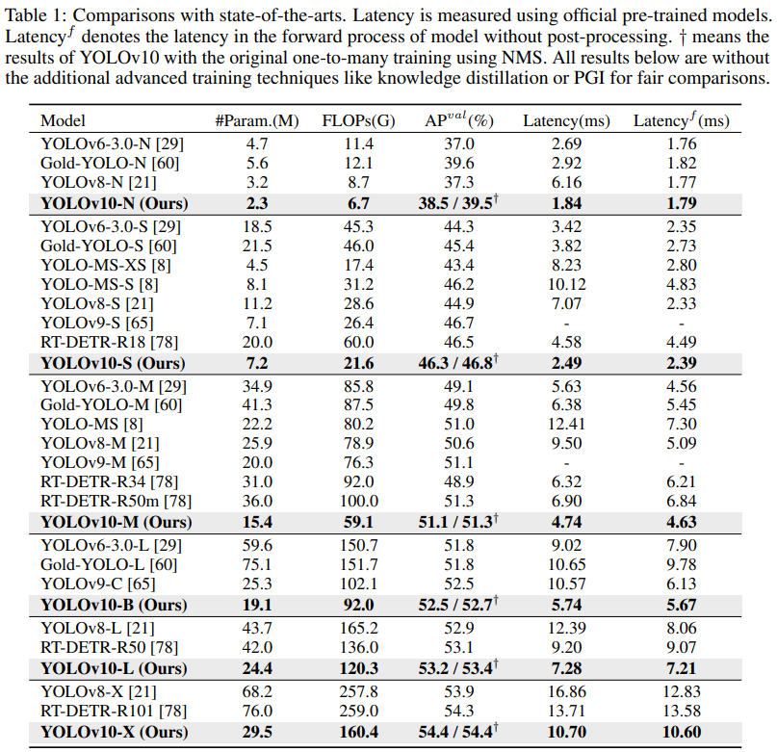
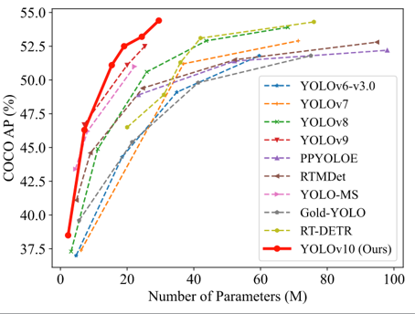
Speed: Thanks to its NMS-free architecture, YOLOv10 significantly boosts inference speed. For instance, the small YOLOv10-S runs in ~2.5 ms per image (≈400 FPS) vs ~7.1 ms for YOLOv8-S.
Efficiency: It uses ~1.8× fewer parameters than YOLOv8-L for the same performance, resulting in superior accuracy-per-compute.
Overall, YOLOv10 outperforms earlier versions and matching transformer-based models’ accuracy while maintaining much lower latency

Slide 22
Major differences of Yolo V10 over Yolo V8
Aspects | YOLO V8 | YOLO V10
Architecture | CSP-based backbone with C2f conv modules (no attention). PAN neck for feature fusion. | CSP backbone + Transformer modules (Partial Self-Attention) for global features. PAN neck retained for multi-scale fusion.
Detection Head | Single detection head (one-to-many assignment); produces multiple overlaps per object – requires NMS to filter outputs​ | Dual heads: one-to-many + one-to-one. One-to-many head for training, one-to-one head provides one prediction per object – NMS-free inference
Post-processing | Non-Maximum Suppression is needed to remove duplicate predictions before output | No NMS needed – one-to-one head directly outputs final detections
Model Size | Relatively larger models for a given accuracy (e.g. ~43.7 M params in YOLOv8-L)​ | More compact models – ~1.8× fewer parameters for similar accuracy (24.4 M in YOLOv10-L)​
Inference Speed | Slower inference due to NMS overhead (e.g. ~7.1 ms per image for YOLOv8-S)​ | Significantly faster inference (no NMS). For example, ~2.5 ms per image for YOLOv10-S
Accuracy (COCO) | Strong accuracy: ~52.9% AP | Equal or higher AP: ~53.4% AP
Architecture | CSP-based backbone with C2f conv modules (no attention). PAN neck for feature fusion. | CSP backbone + Transformer modules (Partial Self-Attention) for global features. PAN neck retained for multi-scale fusion.

Slide 23
Comparison

Slide 24
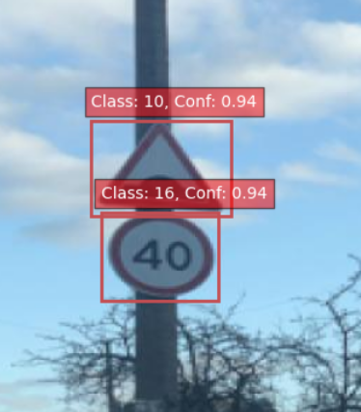
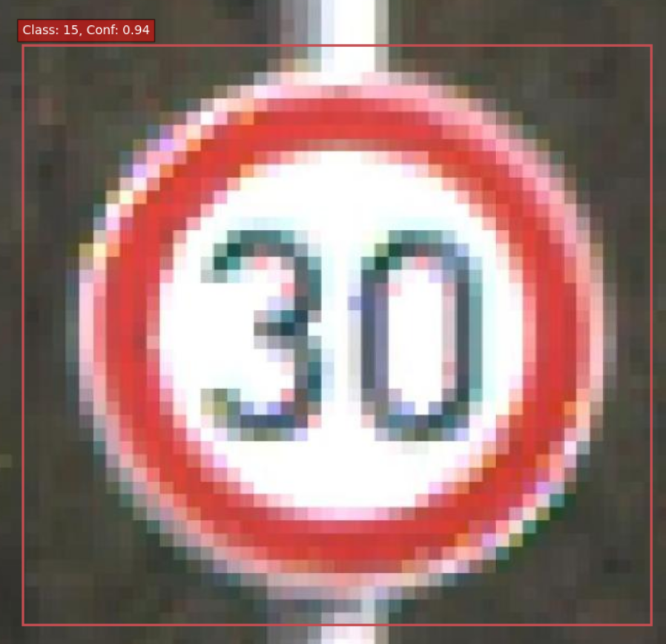
Experimentation
In order to check the performance of the various YOLO models, we explored the possibility of implementing various YOLO models on a Road Sign Detection problem. Performance of various models is measured using IoU score. They are tabulated below
Model | IoU score
Yolo V1 | 0.6620
Yolo V5 | 0.5198
Yolo V8 | 0.7502
Yolo V10 | 0.8311

Slide 25
Architecture’s impact on accuracy improvement
YOLOv1 ⇒ YOLOv5 - Feature Refinement & Robust Backbone.
CNN-based architecture → Presented with enhanced feature extraction via CSPDarknet
Better Feature Combination → Path Aggregation Network (PANet) for detection at multiple scales
Improved Anchor Selection → Automatic anchor tuning with precise bounding boxes
YOLOv5 → YOLOv8 – Intelligent And Faster Detection
Anchor-Free Design → Direct bounding box predictions with minimal error.
Better Loss Functions → CIoU(Complete IoU) with enhanced object localization.(detect fast and small objects)
Better training strategies → AdamW optimizer & dynamic learning rate.
YOLOv8 → YOLOv10 – Revolutionary Upgrades
Dual Label Assignment → More accurate classification & detection. Directly predicts the bounding boxes, labels, and confidence scores.
NMS-Free Object Detection → Direct end-to-end detection with no NMS(Non-Maximum Suppression)
Transformer-based Modules → Global context capture with improved accuracy.
Each variant of YOLO improved feature extraction, object localization, and training strategies while maintaining real-time speed.

Slide 26
Conclusion
Greater data size requires a corresponding growth in model size.
The utilization of the COCO dataset necessitates a more comprehensive model with a robust architecture, leading to enhanced accuracy from YOLO V1 to V5, V8, and V10.
This trend does not necessarily apply in all scenarios.
Testing has been conducted on both single images and large datasets:
YOLO V10 performs more effectively on large datasets.
YOLO V1 and V5 are more effective when processing single images.
The progression of YOLO versions has revolutionized object detection by improving efficiency and accuracy.
Its like a tale of continuous improvements with smarter choices, fast learning capability lead to real-time high accurate object detection.

Slide 27
Questions | Comments
?

